Slide 1
Why should LPIA join ICMA
Peter Ágh
December 8, 2017, Bauska, Latvia

Slide 2
ICMA who we are
Founded in 1914
ICMA is the premier local government leadership and management organization
Currently over 11.000 members in more than 60 countries
Contract and donor funded (USAID, World Bank, US Dept. of State, E.U.,…)

Slide 3
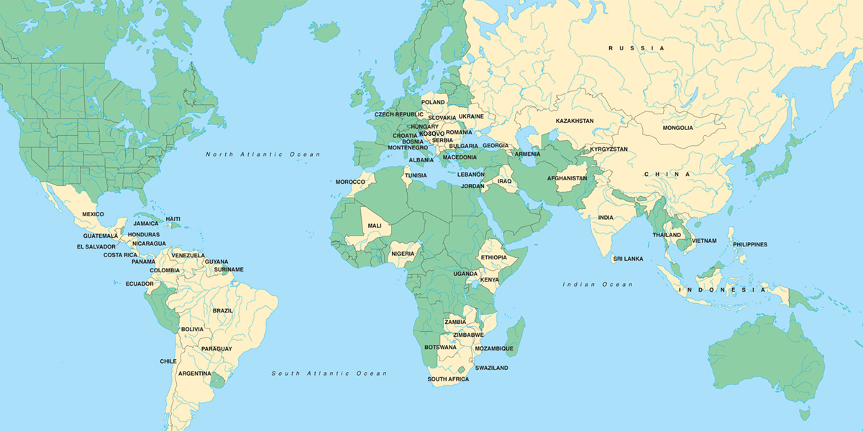
Global reach – current and past projects

Slide 4
International Affiliates
ICMA maintains affiliate relationships with local government professional organizations worldwide. These mutually beneficial partnerships are formalized by signed agreements that commit both organizations to:
Collaborate in the exchange of leading practices and expansion of each organization's knowledge base
Expand the international perspectives of each organization's individual members
Join resources where appropriate to more effectively foster professional local government management worldwide.
In maintaining these relationships, senior officials of each organization attend each other's conferences; liaisons assigned by the ICMA International Committee and organization staff establish annual work plans and contribute to each other's publications; and members engage in one-on-one exchanges through the International Management Exchange Program.

Slide 5
Affiliates by country
Australia Local Government Managers Australia
Canada Canadian Association of Municipal Administrators
China ICMA China Center
Czech Republic Association of Secretaries of Urban and Municipal Authorities of the Czech Repub
Denmark National Association of Chief Executives in Danish Municipalities (KOMDIR)
Georgia Municipal Service Providers' Association (Georgia)
Honduras Honduran Municipal Association (AMHON)I
India City Managers' Association, Gujarat
India City Managers' Association, Karnataka
India City Managers' Association, Orissa
Indonesia Indonesia Municipalities (APEKSI)
Indonesia Indonesian Regencies Cooperation Agency (APKASI)
Ireland County and City Managers' Association – Ireland
Israel Union of Local Authorities in Israel
Kenya The Association of Local Government Authorities of Kenya
Mexico Mexican Association of Municipalities (Asociacion Di Municipios De Mexico, A.C.)
Nepal Municipal Association of Nepal
Netherlands Dutch City Managers Association (Vereniging Van Gemeentesecretarissen)
New Zealand New Zealand Society of Local Government Managers
Norway Norwegian Forum of Municipal Executives
Philippines League of Cities of the Philippines (LCP)
Romania The Association of Public Administrators in Romania (AAPRO)
Russia Russian National Congress of Municipalities
Slovakia Slovak City Managers Association
South Africa Institute for Local Government Management of South Africa
South Korea Korean Urban Management Association
Sri Lanka Federation of Sri Lankan Local Government Authorities
Sweden Association of Swedish City Managers (Svenska Kommundirektorsforeningen)
Tanzania Association of Local Authorities of Tanzania (ALAT)
United Kingdom Society of Local Authority Chief Executives & Senior Managers (SOLACE)
Vietnam Association of Cities of Vietnam (ACVN)

Slide 6
Why Knowledge Network
Writing, research, and practice since 1930
Annual data collection since 1994
Consistent definitions driven by city and county managers

Slide 7
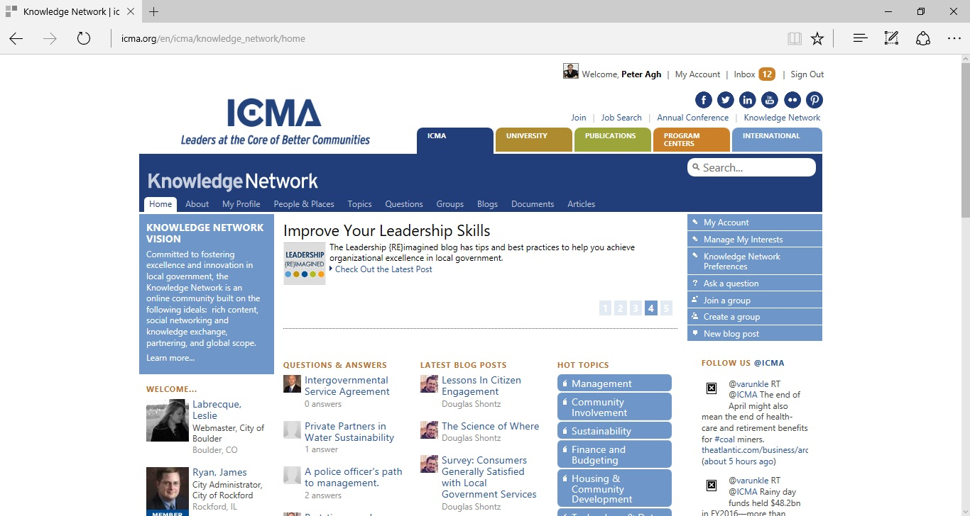
Knowledge Network

Slide 8
Future Conferences
Oslo, Norway – ICMA Europe June 18-20, 2018
Baltimore, Maryland, USA September 23-26, 2018
Nashville/Davidson County, Tennessee, USA October 20-23, 2019
Toronto, Ontario, Canada September 27-30, 2020
Portland/Multnomah County, Oregon, USA October 3-6, 2021
Columbus/Franklin County, Ohio, USA
September 18-21, 2022

Slide 9
Peter Ágh
ICMA Europe
Regional director of International City Managers Association (www.icma.org)
Advisor to the Mayor, Bratislava, Slovakia (www.bratislava.sk)
President of Slovak City Managers Association (www.apums.sk)
pagh@icma.org
+421 (917) 844 787

