Slide 1
Innovation Center
Riga, 2017

Slide 2
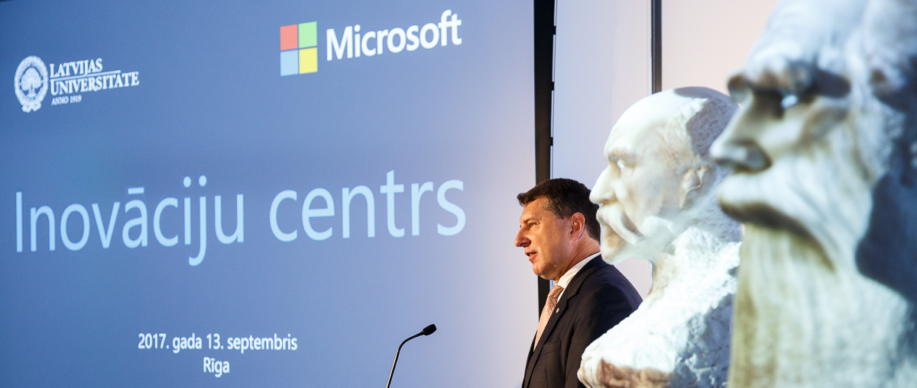
University of Latvia and Microsoft Innovation Center
LUMIC mission is
To enable and promote digital transformation and development of innovative solutions in Latvia by establishing an open space where industry professionals, public sector representatives, students, researchers, entrepreneurs and Microsoft experts can engage and work together.
Notes:
Digital transformation is not a myth, but reality we need to work upon together to be competitive and mark ourselves on global economical map.
The need of one function solutions is over and are replaced by innovative solutions covering all cases and challenges and requers best of technology.
Different knowledge and experience is requred form the evolved counterparts for the innovative result.
Share instead of one man effort – liekam galvas kopā.

Slide 3
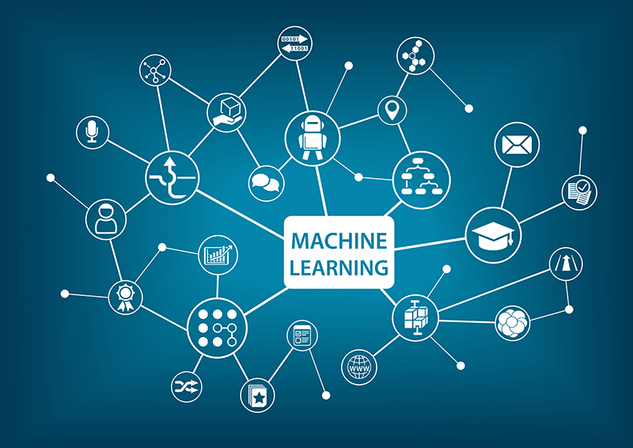
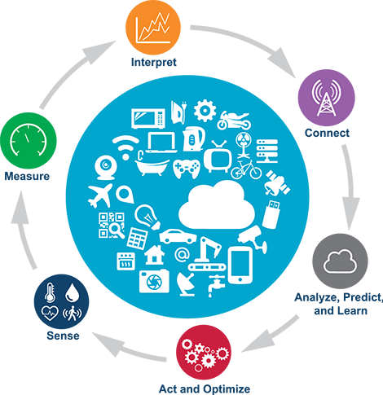
Digital transformation processes
LUMIC focus in achieving excellence
Machine Learning
Development of computer programs
Open Big Data
Adoption, usage/ consumption
Nurturing
Innovation
Artificial
intelligence
IoT
Computer systems, speech recognition
translation
Connecting devices & exchange data
Notes:
Sience is accessible for business and helps solving society matters.
All new sinces – machine learning, big data, artificial intelligence, exits science labs and democratization allows all of us to use the best of breed.

Slide 4
Students & K12 pupils Academics – researchers & scientists Startups & entrepreneurs Developers & IT Professionals Independent Software Vendors Government decision makers
LUMIC is working to empower
Notes:
All of us have our spceific education, life and work exprience, hobbies and knowledge gainf from social groups and engagement.
We all are experts of certain topics and what makes coworking so productive.
Inovation center is workspace to engage professors, decision makers, students, developers to engage and think together for best solutions.
Inovation center is place to validate your ideas and search for best technological solution and share the results.

Slide 5
Entrepreneurship development
Skills development
For entrepreneurs to grow and develop new business models
For students, startups and developers to improve technical and digital skills
Innovation workshops
Startup incubation
Startup camps
Digital & technical trainings
Train the Trainer
Hour of code
Certification
Value day
Activities are structured in four major programs
Apps development
Ecosystem development
For IT professionals to prototype new solutions and test existing ones
For government, industry and academia to strengthen the local ICT market
IT pro & Dev camps
R&D advancement opportunities
Community & industry meetings
New curriculum
Hackathons

Slide 6
LUMIC project portfolio
Intelligent transport system
Document and work-flow management
Cloud-based education platform
BOTs in the public sector
Security solution based on used behavior profiling
Big data-based cancer prediction tool

Slide 7
Katrin Gulbis, MIC Engagement Manager
katrin.gulbis@mic.lu.lv
+371 29229900
University of Latvia and Microsoft Innovation Center
Kalpaka Blvd 4, Riga

